Slide 1
“As soon as there was life,
there was danger”
Joseph LeDoux
New York University
NYU Langone Med School
Nathan Kline Institute
“As soon as there is life,
there is danger”
Ralph Waldo Emerson

Slide 2
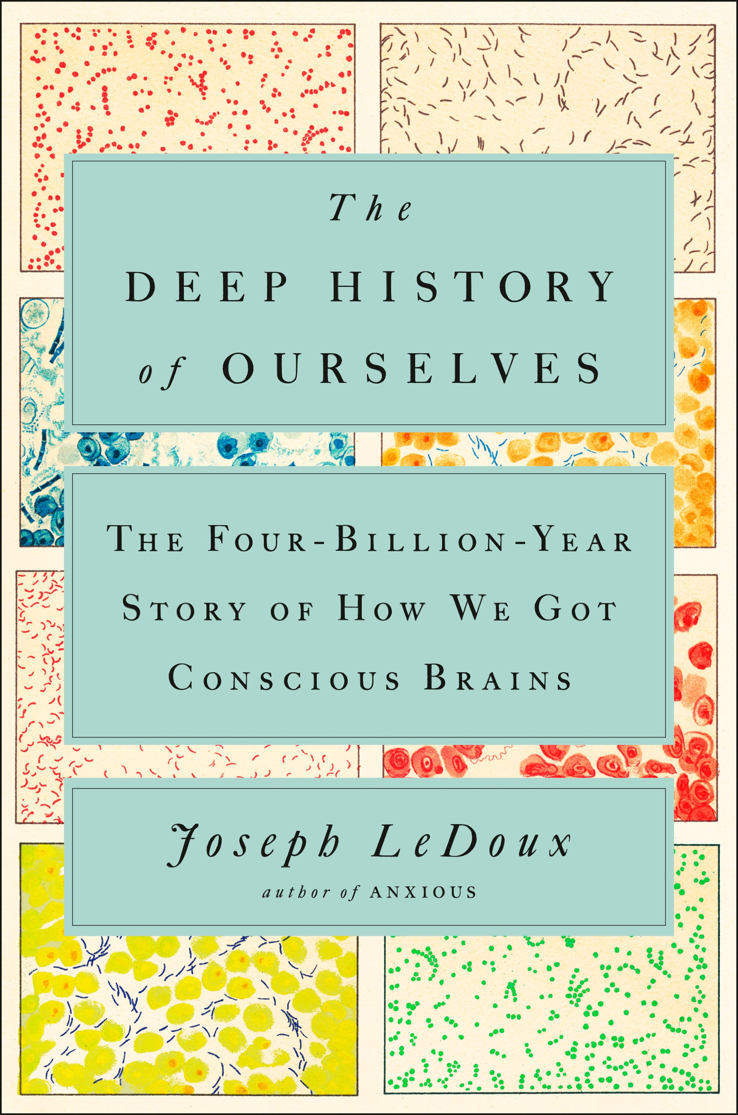

Slide 3
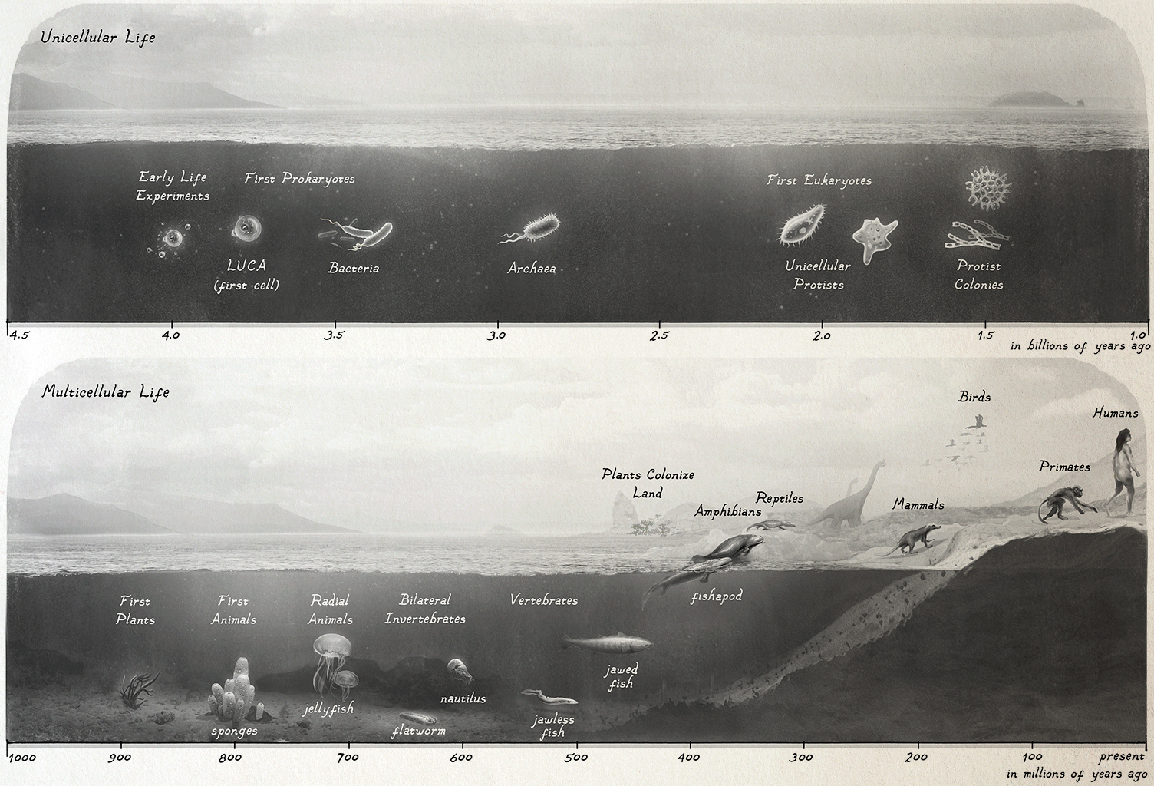
Life was unicellular for the first 3 billion Years
PROJECTING HUMAN EXPEREINCE ONTO OTHER ORGANISMS
HUMAN
EXPEREINCE
SURVIAL IMPLEMENTATIONS
IN MAMMALIAN BEHAVIOR
-DEFENSE: freeze, flee………………………
-ENERGY MANAGEMENT: seek food…….
-FLUID AND ION BALANCE: drink ………..
-REPRODUCTION: sexual intercourse ……
FEAR
HUNGER
THIRST
PLEASURE
Multicellular life is only about 900 million years old
Humans 8 MYA
Bilateral life 630 MYA
Mammals 210 MYA
Vertebrates 530 MYA

Slide 4
Why Did I Write this Book
About the History of Life?

Slide 5
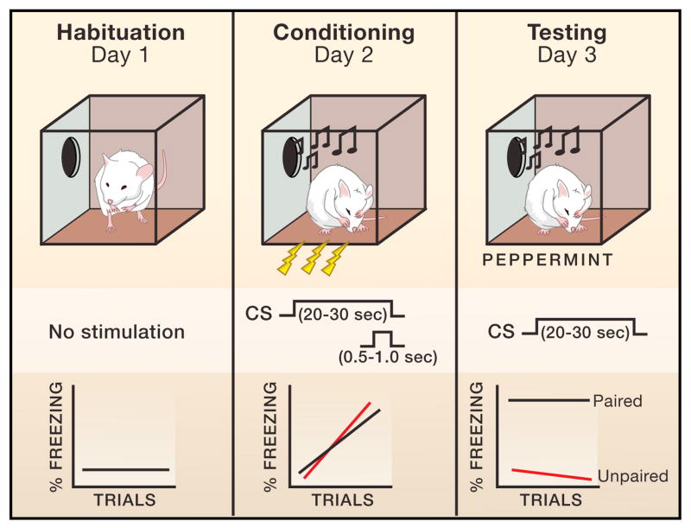
Pavlovian Threat Conditioning
35 Years of Pavlovian Fear Conditioning
Basic Neural Circuitry
WHAT COMES AFTER
KNOWING THE CIRCUIT?
AMYGDALA

Slide 6
Three Step Approach to the Neural Basis of Behavior
(Kandel and Spencer, 1967; Kandel 1976)
Characterize the behavior
Identify the circuit
Determine the cellular & molecular mechanisms

Slide 7
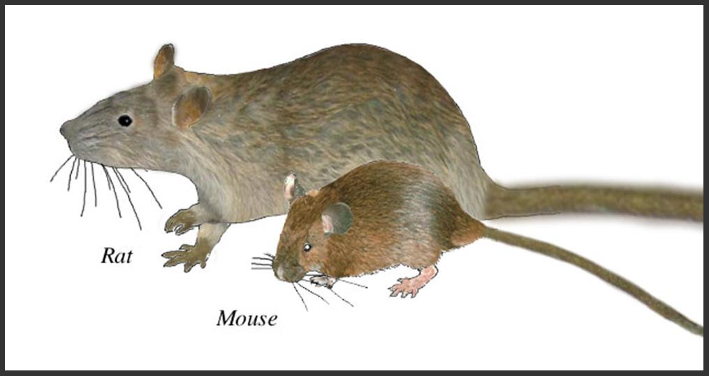
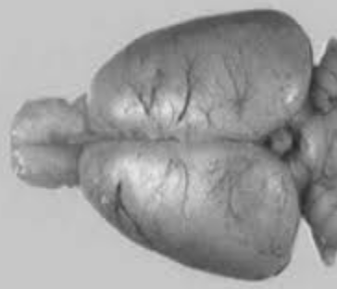
IN THE 1960s MAMMALIAN BRAINS WERE VIEWED AS TOO COMPLEX TO STUDY CELLULARAND MOLECULAR MECHANISMS

Slide 8
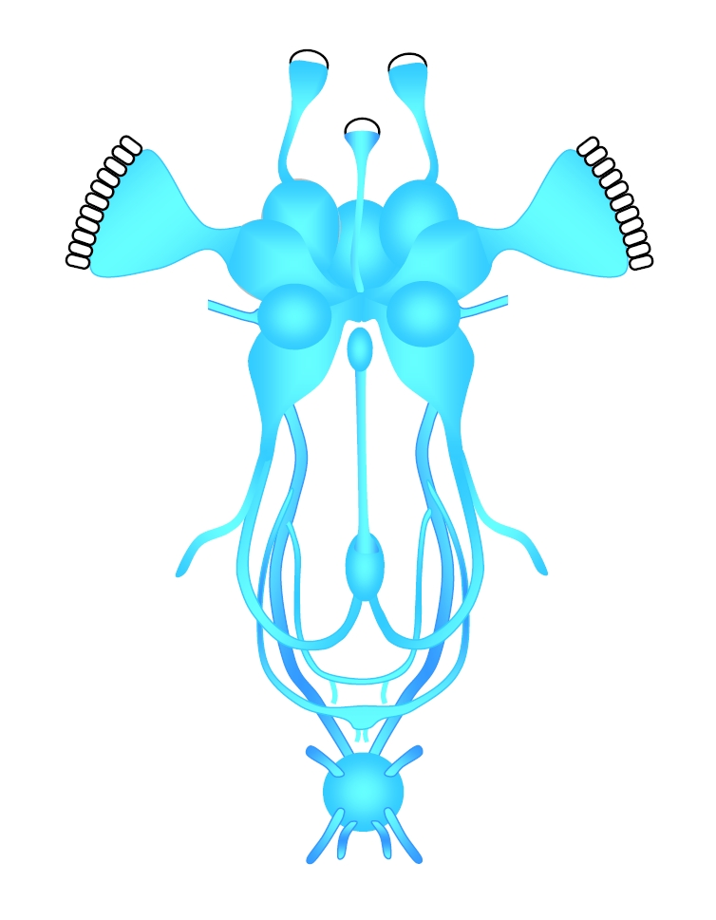
Invertebrate Nervous Systems Are Simpler
and More Tractable

Slide 10
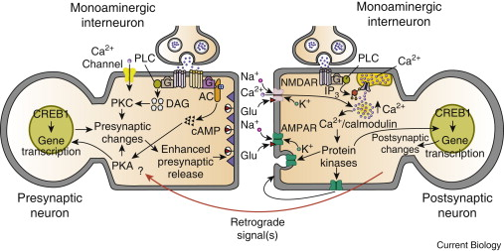
INPUT NEUON
RECEIVING NEUON
All of these molecules discovered in plasticity and learning in
invertebrates are also involved in plasticity and learning in mammals

Slide 11
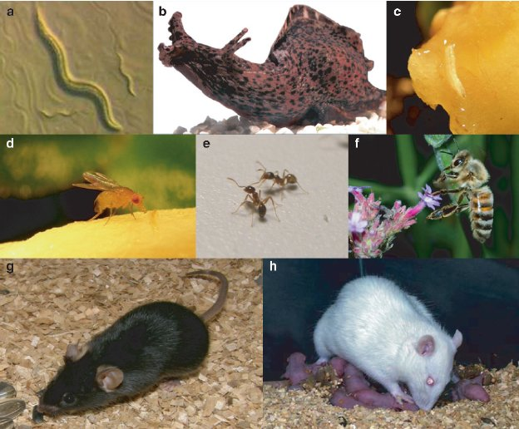
Genes and Molecules Underlying Learning About Danger
Are Conserved in Vertebrates and Invertebrates

Slide 12
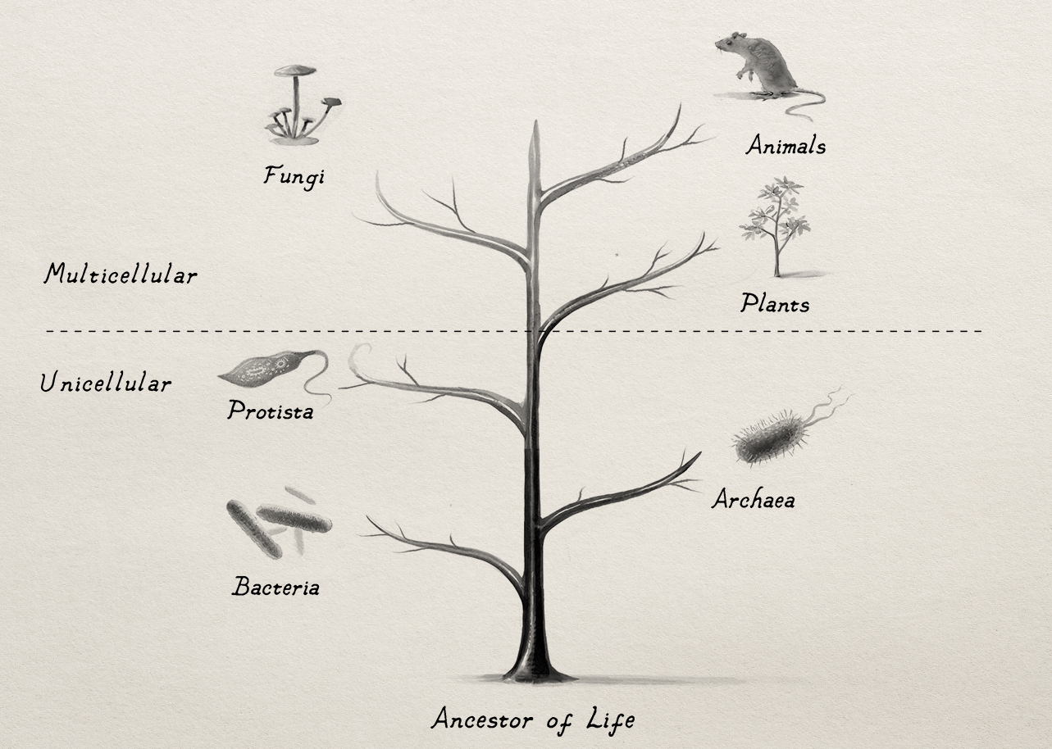

Slide 13
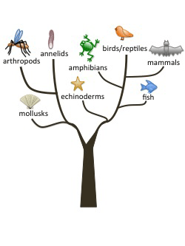
Animal Tree of Life
INVERTBRATES
VERTEBRATES
Common
Ancestor of
Bugs and Mammals
~600-700 MYA

Slide 14
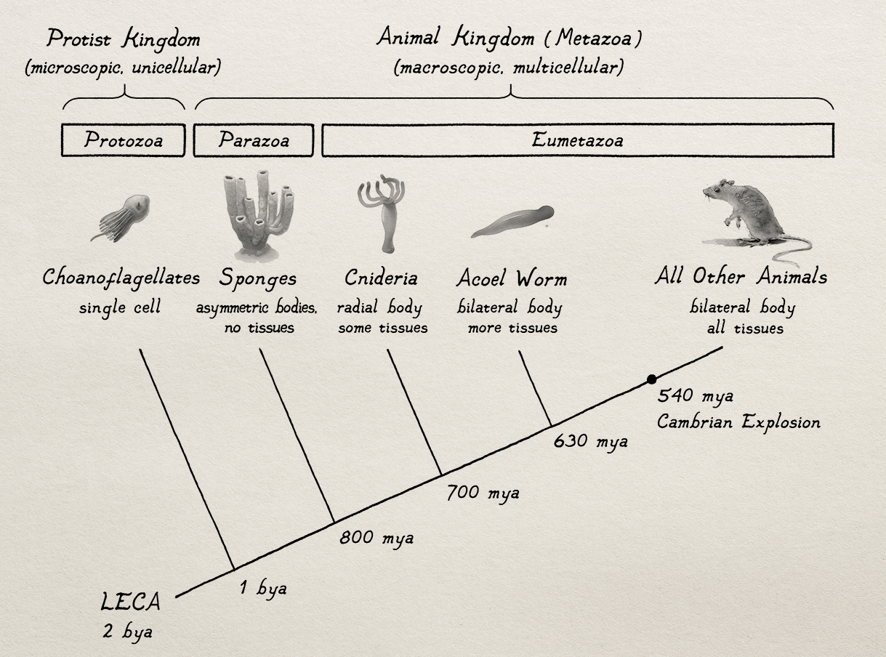


Tracing Genes and Molecules Underlying Plasticity Related to Danger
(Seth Grant)
Invertebrates
bilateral body
with without spine
Early Vertebrates
bilateral body
with spine
They have
Some of the
same plasticity
molecules as
mammals
520 mya

Slide 15
3 MULTICELLULAR
KINGDOMS
macroscopic
microscopic
3 UNICELLULAR
KINGDOMS

Slide 16
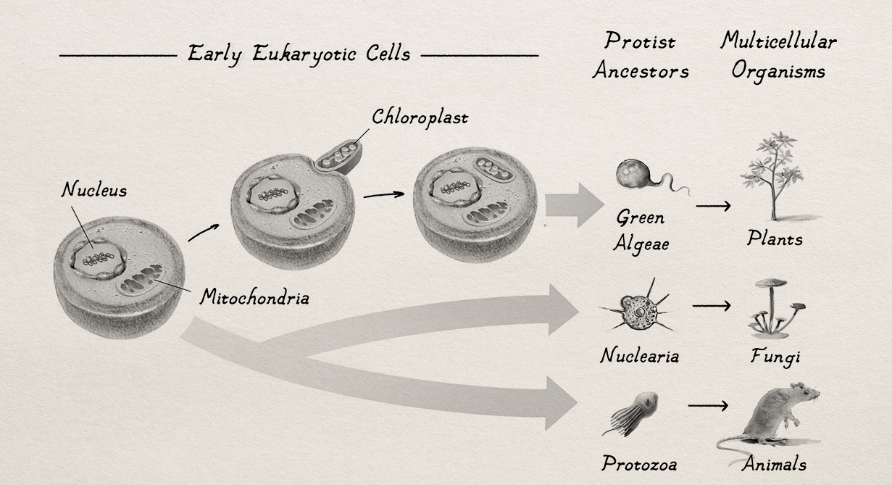
UNICELL PROTIST ANCESTOR OF PLANTS, FUNGI, AND ANIMALS

Slide 17
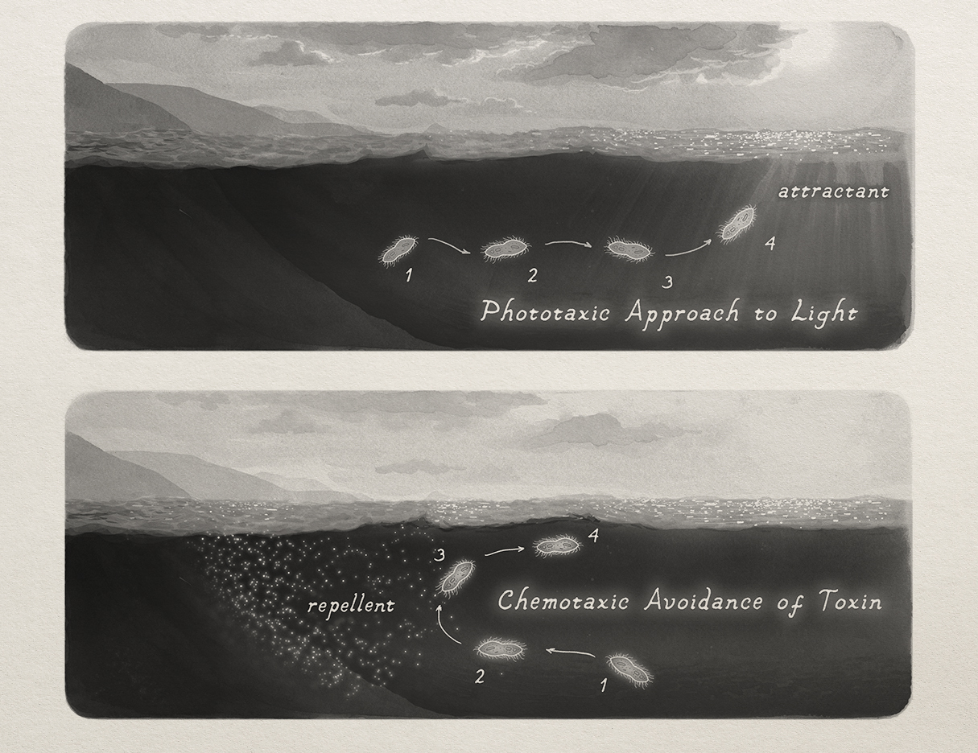
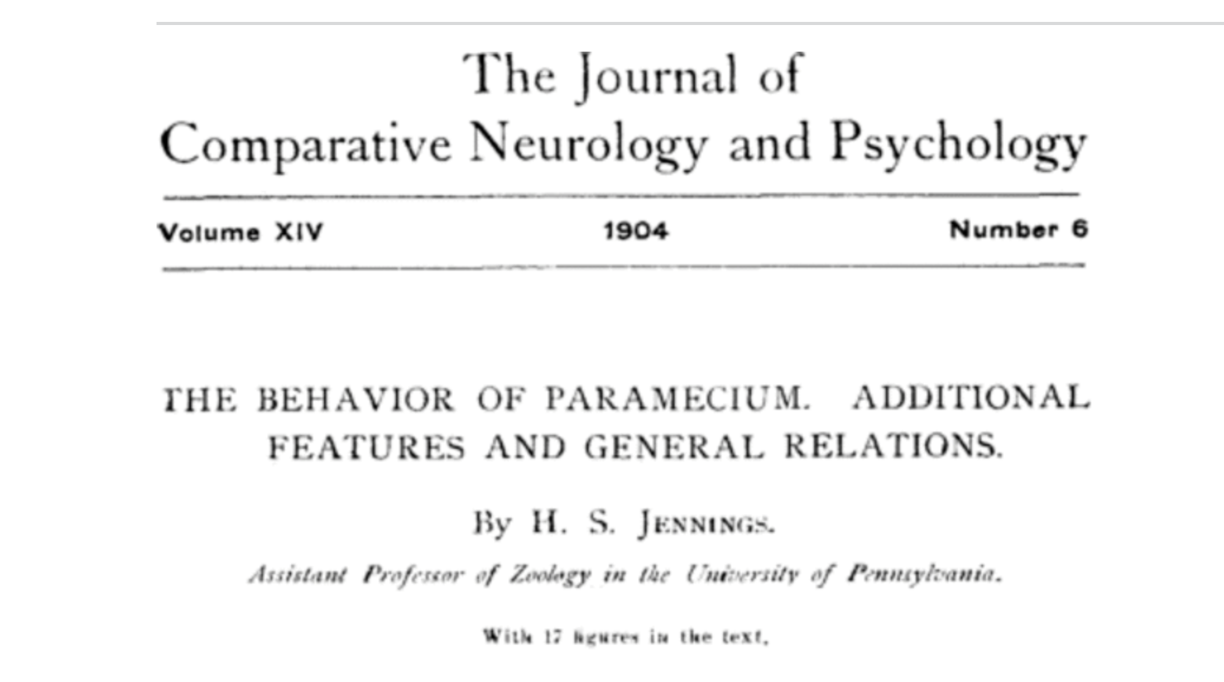
Unicellular Protozoa Behave
Despite Not Having a Nervous System System

Slide 18
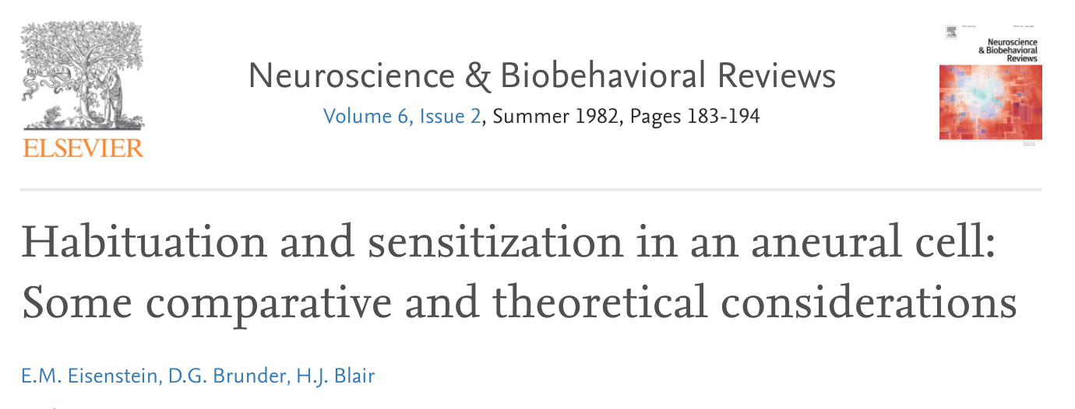
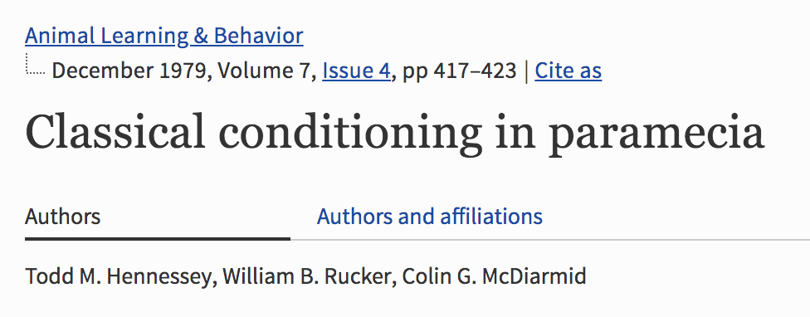
They Even Learn

Slide 19
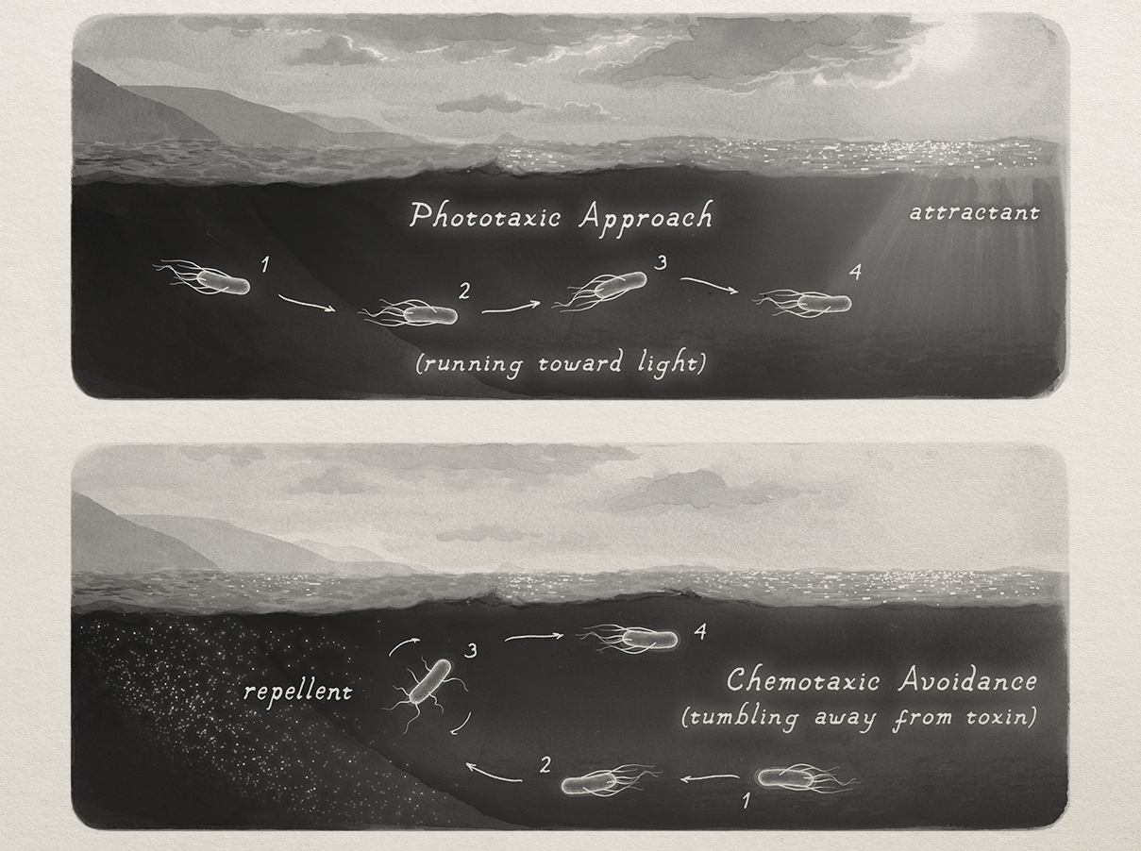
Approach and Avoidance in Bacteria

Slide 20
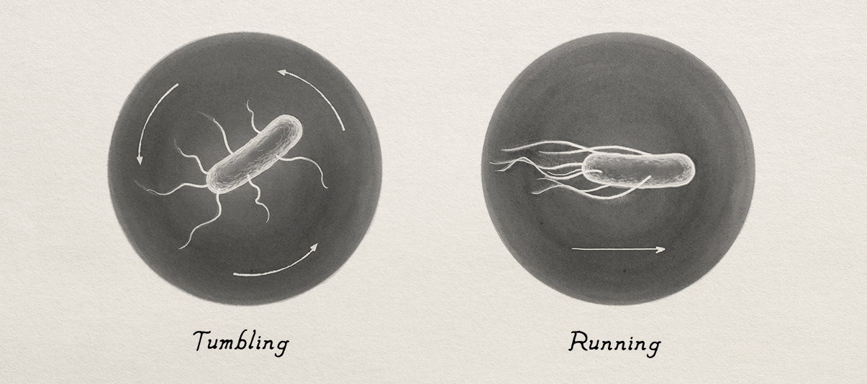

Slide 21
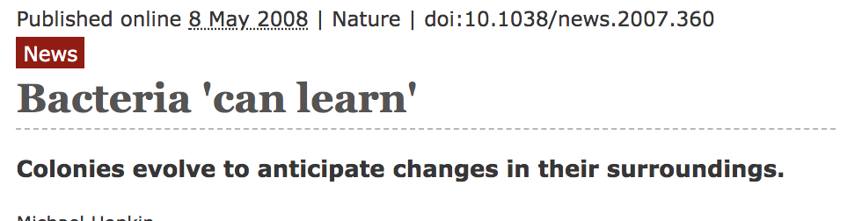
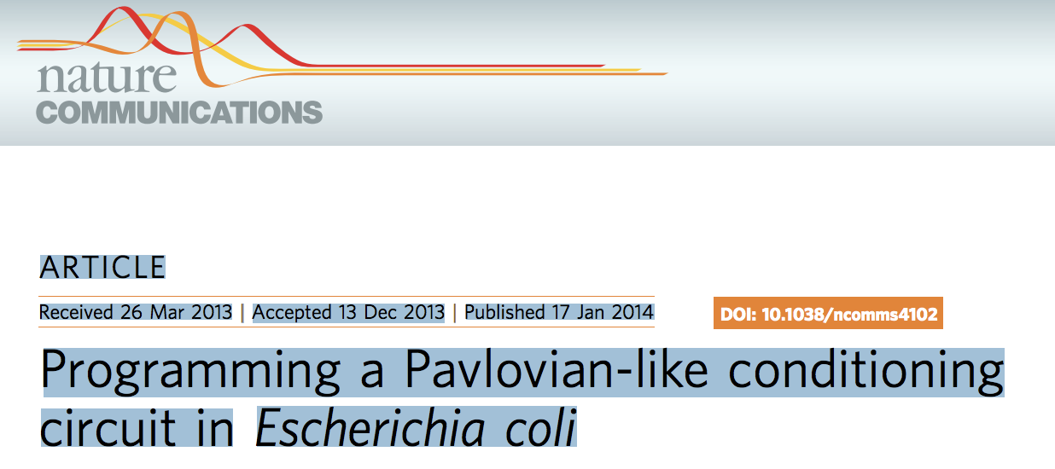
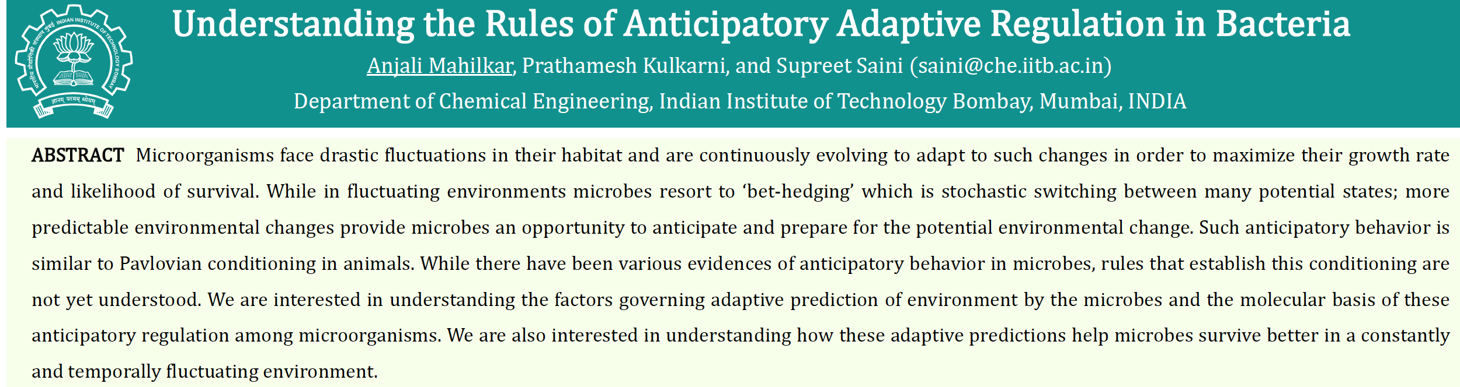
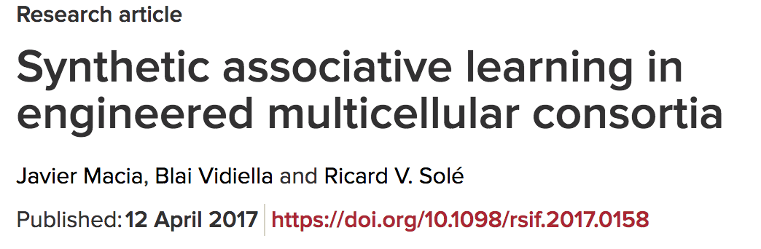
Science News
Scientists Show Bacteria Can 'Learn’
Weizmann Institute of Science
Vladimirov N, Sourjik V (2009) Chemotaxis: how bacteria use memory. Biol Chem 390:1097-1104.
Mitchell, A; Romano, GH; Groisman, B;
Yona, A; Dekel, E; Kupiec, M; Dahan, O;
Pilpel, Y (2009) Adaptive prediction of environmental changes by microorganisms Nature.

Slide 22
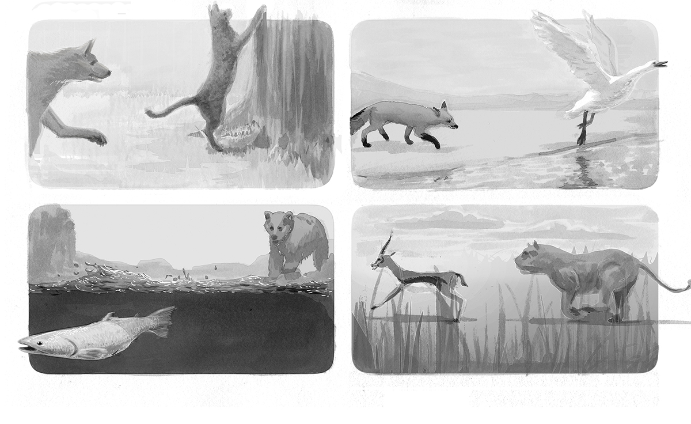
BODY TYPE DICTATES WITHDRAWAL
behavior is as old as life

Slide 23
Life is all about not being dead
without life, “danger” would be a
meaningless notion

Slide 24

“As soon as there is life, there is danger”
Ralph Waldo Emerson

Slide 25
BEHAVIOR DID NOT ARISE AND PERSIST FOR PSYCHOLOGICAL REASONS:
IT ‘S PART OF THE ORGANISM’S SURVIAL TOOLKIT
SURVIVAL REQUIREMENTS OF A CELL
a- physiological viability
-make energy
-balance fluids and ions
-withdraw from harmful agents
b- fecundity
-reproduction
SURVIVAL REQUIREMENTS OF AN ANIMAL
a-maintain physiological viability
-make energy
-balance fluids and ions
-withdraw from harmful agents
b- fecundity
-reproduction

Slide 26
Survival Requirements vs. Tactics (implementations)
Survival Requirements: all animals must satisfy these to survive
Survival Tactics (Implementations): each species’ unique solution tied to its body plan
SURVIAL REQUIREMENTS
(species-general)
-defense against harm
-energy management
-fluid and ion balance
-reproduction
SURVIAL IMPLEMENTATIONS
(species-specific)
-freeze, fight, flee (run, fly, swim, climb)
-digestion (internal, external), photosynthesis
-drink, absorb
-asexual, sexual

Slide 27
BODY TYPE DICTATES WITHDRAWAL
IT’S NOT
BEHAVIOR THAT
IS CONSERVED.
IT’S SURVIVAL
REQUIREMENTS.
YOU HAVE TO BE
ABLE TO ESCAPE
FROM HARM BUT
THE WAY YOU DO IT
IS DICTATED BY THE
BODY YOUR
SPECIES EVOLVED
TO ADAPT YOU ITS
ENVIRONMENT

Slide 28
Our survival responses are a direct manifestation of this history.
This is why we have an amygdala defensive survival circuit.
PROJECTING HUMAN EXPEREINCE ONTO OTHER ORGANISMS
HUMAN
EXPEREINCE
SURVIAL IMPLEMENTATIONS
IN MAMMALIAN BEHAVIOR
-DEFENSE: freeze, flee………………………
-ENERGY MANAGEMENT: seek food…….
-FLUID AND ION BALANCE: drink ………..
-REPRODUCTION: sexual intercourse ……
Projecting our emotions onto other
organisms on the basis of analogy
with human behavior conflates our
emotions with the history
survival behaviors
FEAR
HUNGER
THIRST
PLEASURE

Slide 29
Reporter: Charles, you talk about human bodies in
terms of animal parts but you talk about animals as
if they have emotions. Why do you switch
the emphasis?
Charles: It’s kinder, and more acceptable to the public
to think of animals in human terms than to treat
humans as animals.

Slide 30
Projecting our emotions onto other organisms on the
basis of analogy with human behavior conflates our emotions
with survival behaviors
HUMAN
EXPEREINCE
FEAR
HUNGER
THIRST
PLEASURE
Anthropomorphism has been proposed
to be an innate part of human nature
*innate means it was useful for species survival
*it has nothing to do with truth value as a
scientific contruct
HUMAN
EXPERIENCE

Slide 31
SURVIAL IMPLEMENTATIONS
IN MAMMALIAN BEHAVIOR
-DEFENSE: freeze, flee………………………
-ENERGY MANAGEMENT: seek food…….
-FLUID AND ION BALANCE: drink ………..
-REPRODUCTION: sexual intercourse ……
HUMAN
EXPEREINCE
FEAR
HUNGER
THIRST
PLEASURE

Slide 32
THROUGH STUDIES OF BEAHVIORAL
AND PHYSIOLOGICAL RESPONSES
ELICITED BY THREATS
The Amygdala Became a
FEAR CENTER
AMYGDALA
FEAR
Fear
Responses
Threat

Slide 33
What’s Wrong With the Amygdala Fear Center Idea?
1. Behavioral and physiological responses do not always correlate strongly with subjectively experienced fear; they should if they are all products of fear in the amygdala.
2. Non-consciously processed threats elicit both amygdala activity and behavioral and physiological responses in the absence of subjective awareness of the stimulus and without any feeling of fear.
3. Damage to the amygdala interferes with the ability of threats to elicit behavioral and physiological responses but does not necessarily eliminate feelings of fear.

Slide 34
4. Medications used to treat pathological fear can have greater effects on behavioral (avoidance, timidity) or physiological responses (hyper-arousal) than on subjective feelings. If the experience of fear and behavioral and physiological responses that are also expressed are all products of the amygdala, the medications should affect them the similarly.
5. The amygdala fear center idea is based on behavioral models of predation. While the amygdala does contribute to defensive reactions to predatory dangers, fear does not have an exclusive contract with the amygdala predatory defense circuit—we can fear dying from starvation, dehydration, hypothermia, hypoxia, all of which depend on other circuits. Fear cannot be explained in terms of an innate response of any one survival circuit.

Slide 35
Neuroscientists Explain “Fear” Conditioning in terms of
Systems, Cells, Synapses and Molecules
This logic works equally well in all animals (vertebrates and invertebrates)
No Need to Call Upon Concepts Such as “Fear”
Hebbian
(monosynaptic)
CS
US
Non-Hebbian
(heterosynaptic)
neuromodulator
THIS DOES NOT MEAN THAT “FEAR” IS AN IRRELEVANT CONSTRUCT.
IT’S JUST NOT WHAT CAUSES INNATE RESPONSES
ELICITED BY CONDITIONED THREATS IN ANIMAL OR HUMAN STUDIES

Slide 36
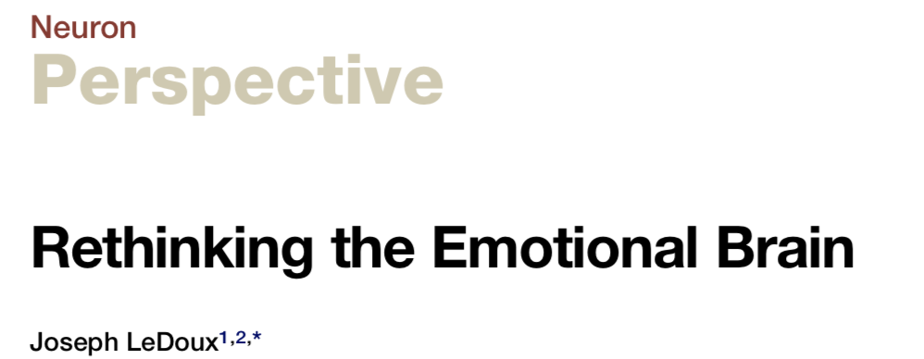
2012
AMYGDALA “FEAR CENTER”
Sensory
System
FEAR
Threat
Fear Behavior
AMYGDALA DEFENSIVE SURVIVAL CIRCUIT
Sensory
System
Defensive
Survival
Circuit
Threat
Defensive Behavior

Slide 37
WHY DOES IT MATTER HOW
WE TALK ABOUT FEAR?
Part 1: Clarity

Slide 38
Finding:
Crayfish treated with a benzodiazepine were more exploratory (less inhibited) in a chamber where
they received electric shock
Fossat et al, 2014, Science
Headlines:
Science: Anxious Crayfish Can Be Treated Like Humans
NYT: Even Crayfish Get Anxious
BBC: Crayfish May Experience a Form of Anxiety

Slide 39
Finding:
Flies stop moving (“freeze”) when in danger
David Anderson
an emotional state, “possibly analogous to fear in mammals,” lies between the threat and the freezing behavior in flies, and by studying flies we can learn important things about human emotions.
Headlines:
“Flies have feelings: fear and maybe more”
“Flies experience emotions like fear, and might offer
insights into how the brain makes feelings.”
Anderson says that’s not what he said: but if you bait the hook don’t be surprised
if the fish bite

Slide 40
Part 2:
“It’s Just Semantics”
(but Semantics Really Matter)

Slide 41
Francis Bacon (1620) Scientists should be vigilant and guard against tacitly granting reality to things simply because we have words for them.
George Mandler and William Kessen (1964) The common language is full of quasi-psychological assertions, and the language in which these are framed is inadequate.... Atoms do not study atoms….The fact that man studies himself and that he has archaic notions which pesist in the daily behavior of all men puts a major stumbling block in the path of scientific psychology.
Jack Block (1995) Psychologists have tended to be sloppy with words. We need to become more intimate with their meanings, denotatively and connotatively, because summary labels and shorthand chosen quickly will control—often in unrecognized ways—the way we think subsequently.
Kurt Danzinger(1997) Psychologists did not invent the concept of ‘emotion’…to account for certain empirical findings; they obtained certain empirical findings because of their desire to investigate a set of events which their culture had taught them to distinguish as emotional.

Slide 42
MELVIN MARX (1951)
There is a semantic danger that results when a common language term is used as a scientific name for an intervening variable or hypothetical construct. In such a situation some will be inclined to apply the common meaning.
When this happens, the variable or construct becomes infected with the subjective properties that the scientist was trying to avoid.
In the case of “fear,” the common meaning is often taken to be the intended meaning, and there lies the problem.

Slide 43
Anxiolytic Drug Development
Illustrates the
Consequences of
Semantic Ambiguity
Behavioral tests of fear/anxiety reflect a central state of fear or anxiety
Drugs that alter fear/anxiety behavior change the central state in animals
Changing this central state should make people feel less fearful or anxious

Slide 44
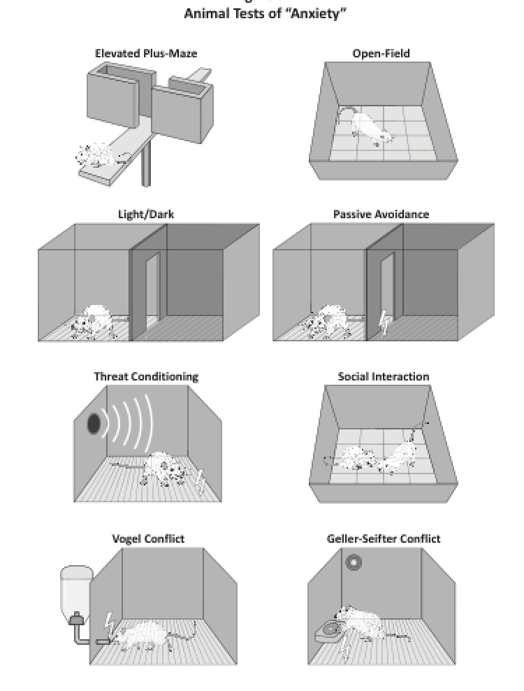

Slide 45
Since the 1960s, billions of dollars and probably millions of animals
have gone into the search for new and better anti-anxiety
medications.
In 2010 Andrew Witty, CEO of GSK, concluded the effort has failed
and new investments would not be made because of the low
probability of success.
Andrew Holmes, a leading researcher, reached a similar conclusion:
“these efforts have been disappointing, as promising results with
novel agents in rodent studies have very rarely translated into
effectiveness in humans”.

Slide 46
TWO MEDICATION SCENARIOS IN SOCIAL ANXIETY
Scenario A: anti-fear/anxiety meds
-the medication will turn off your
fear center.
-you will be able to go to the
party and not feel afraid or anxious.
Scenario B: physical symptom meds
-the medication affects systems that
control behavioral and physiological
responses in challenging situations.
-you will find it easier to go to the party
(be less avoidant) and will feel less jittery
(less aroused).
-while you will probably still feel anxious,
you will be better able to cope with
the threatening situation and can use it
as a way to become physically more
comfortable being there.
-this is not a cure but it might help you
cope with your symptoms.
This is what the
drug companies,
researchers, psychiatrists
and patients assume (hope)
will happen—
It’s an anti-anxiety drug
and will reduce fear and anxiety
This is what the animal research
suggests will happen—
It will reduce behavioral inhibition
(timidity) and hyper-arousal

Slide 47
We need a conception of fear and anxiety that recognizes the
importance of innate circuits which have been inherited
from animals
But one that does not confuse those circuits with circuits
that underlie conscious feelings of fear or anxiety

Slide 48
For therapy to succeed both subjective states
(feelings of fear and anxiety) and objective
responses (behavior and physiology) have
to change. Simply assuming that subjective
experience will come along for the ride when
a treatment changes objective responses
Is not the solution.
People Experience
Fear Here
Cognitive Interpretation Circuit
FEAR
Sensory
System
Defensive
Survival
Circuit
Threat
Defensive Behavior
Drugs
developed in
animal studies are
designed to
work here

Slide 49
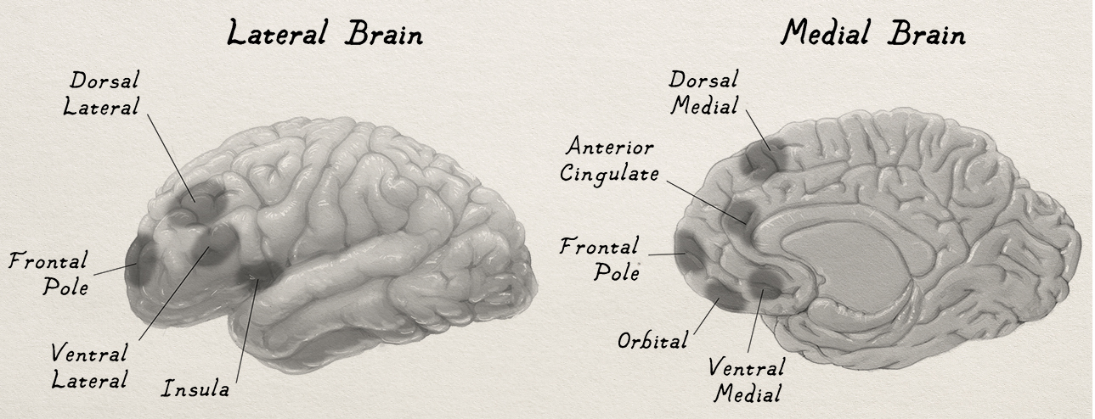
Possible Components of a PFC Higher Cognitive Networks
LOWER ORDER INPUTS TO PFC THAT MIGHT VARY BETWEEN NON-EMOTIONAL AND
EMOTIONAL STATES AND DIFFERENT KINDS OF EMOTIONAL STATES
Perceptual (visual, auditory, touch, pain, taste, olfactory)
Memory (semantic, episodic, autobiographical)
Schematic (emotion schema, self schema)
Survival Circuit (brain arousal, behavior, ANS acclivity, hormones, feedback from body)

Slide 50
Inputs to Working Memory that Contribute to the Conscious Experience of Fear
LOWER-ORDER INGREDIENTS
non-emotional states
LOWER-ORDER INGREDIENTS
emotional states
Self Schema
Emotion
Schema
Episodic
Memory
Body
Feedback
Semantic
Memory
Brain Arousal
Circuits
Appraisal
Monitoring
Attention
Sensory
Processing
Survival
Circuit
FEAR
Working
Memory
Defensive
Energy Management
Fluid Balance
Thermoregulatory
Reproductive
Metacognition
Introspection
Verbal Report

Slide 51
Fear is the situational expression in consciousness of a non-conscious mental model
It is an expectation/belief/pattern completion/ cognitive simulation based on knowledge (memory) of what you know about danger and fear, including your personal relation to danger and fear.
It is a consciously experienced non-
conscious narration. The conscious you doesn’t tell the story. It is told to you.

Slide 52
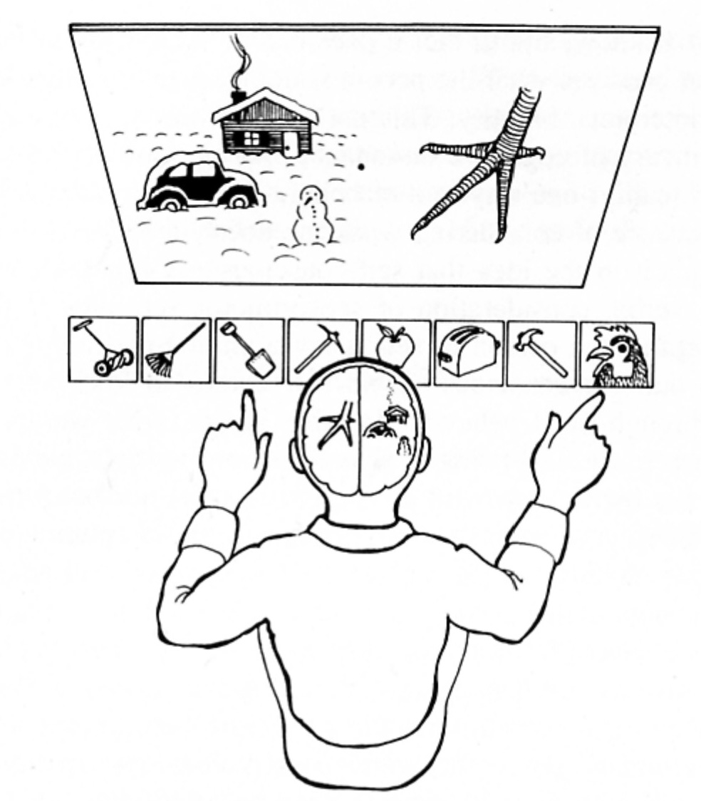
PhD Research 1970s
Q: Why did you pick
those?
A: I saw a chicken claw
so I picked the chicken, and you need a shovel to clean up the chicken shit.

Slide 53
Fear is NOT universal--Danger is universal.
All humans must deal with danger, and all cultures
that have words have words for danger, and
words for for experiences that occur when in danger.
But the experience of danger varies across cultures.
Because we can translate words like fear across
languages, we assume people worldwide have
the same basic experience named by the word.
Cultural differences are based on differences in the
schema
Different people within a culture have
different self and emotion schema and different experiences.
Animals, lacking our kind of cognition can’t have
our kind of schema and our kind of fear.

Slide 54
Fear is your cognitive awareness that you are in harms way.
It requires that you know that it is you that is in danger (engages self-awareness)
It depends of your fear schema—your cognitive encyclopedia of knowledge of danger and of your personal relation to danger that you have acquired over the course of your life in your culture or cultures
I also depends on your self schema—your
cognitive encyclopedia of knowledge of “you”
based on autobiographical memory, including
both semantic and episodic autobiographical
memories.

Slide 55
WHAT IS AN EMOTION?
(a narrative-driven subjective experience in a biologically or psychologically significant situation)

Slide 56

deep-history-of-ourselves.com

Slide 57
Songs of Life
“Life”

Slide 58
“As soon as there is life, there is danger”
Ralph Waldo Emerson

Slide 59
CONTROVERSIAL PROPOSAL
Emotions Did not Arise via Natural Selection
But Instead via a Series of Exaptations
in Early Humans
Exaptation 1- Language emerged through the coupling of primate
skills (social communication, hierarchical deliberation, tool use) and
made culture possible (Kolodny and Edelman, 2018).
Exaptation 2- Personal pronouns (I, me, mine) facilitated
representation of one’s self as a subject rather an object
(Michael Lewis, 2014).
Exaptation 3- The ability to represent one’s self in time allowed for
awareness of life’s episodes (Tulving's autonoetic consciousness).
Exaptation 4- Emotions are a special class of autonoetic (Self).
Experiences that occur in significant situations in life.

Slide 60
HYPOTHESIS
The brain mechanisms underlying emotional states of
consciousness are not different from those underlying other states of awareness
What’s different about
*emotional vs. non-emotional experiences
*different kinds of emotional experiences
Inputs Processed by Cortical Higher-Order Consciousness Networks

Slide 61
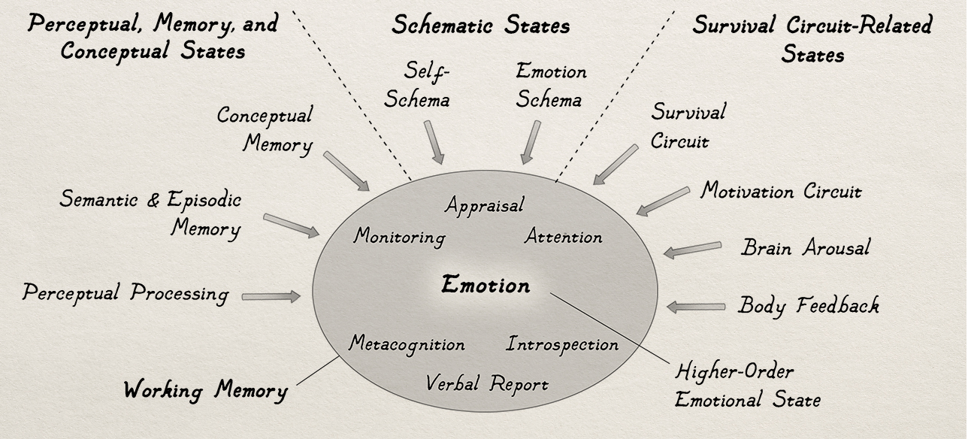

Slide 62
Three Kinds of Consciousness (Tulving)
Autonoetic – A special kind of subjective awareness: awareness
of SELF in one’s personal past and present, and one’s hypothetical
personal futures.
Noetic- awareness of what is present and how this relates to
other things that have been present or might be present, but not
in a personal way made possible by autonoesis.
A-Noetic – mere awareness of the presence of a body and its
surroundings, and their value.

Slide 63
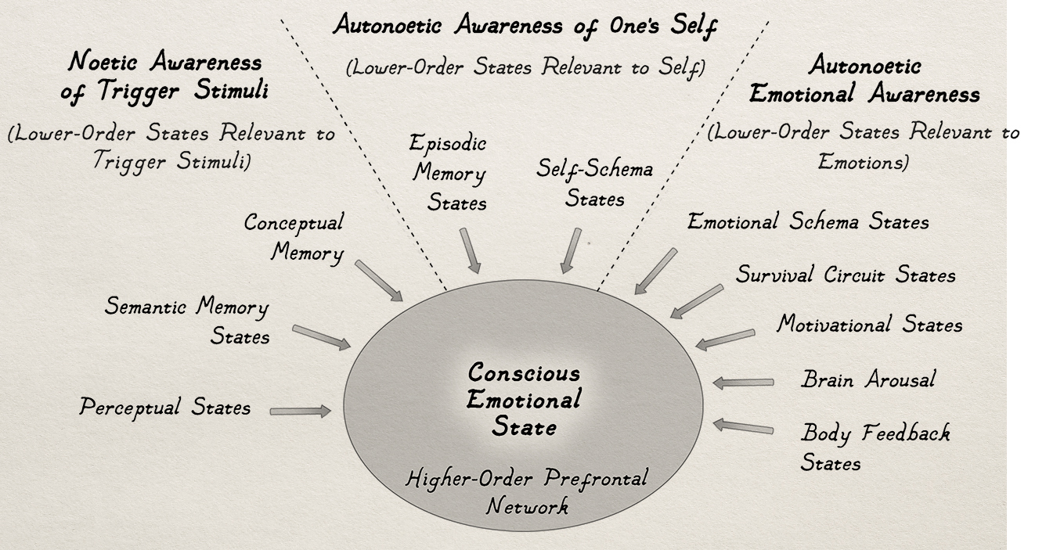

Slide 64
HYPOTHESES ABOUT POSSIBLE SUBSTRATA OF
AUTONOETIC, NOETIC, AND A-NOETIC CONSCIOUSNESS
Autonoetic Noetic A-Noetic

Slide 65
HYPOTHESES ABOUT WHAT KINDS OF CONSCIOUS EXPERIENCES OTHER MAMMALS
MIGHT HAVE, GIVEN THE KINDS OF BRAINS THEY HAVE
Human
Other
Primates
Other
Mammals
Autonoetic
Noetic
A-Noetic
L. Frontal Pole
M. FP and L. PFC
Insula/Medial
yes
no
no
yes
yes
no
yes
yes
yes

Slide 67
-Schema are bodies of knowledge acquired by the individual
as part of a culture
-This contrasts with the more typical view of prototypical schema
-Self and emotion schema interact to make emotions personal
-They function as non-conscious templates out of which one’s
conscious experiences arise
Fear Schema
Pattern Completion to Fear
2
3
3
1
1
FEAR
4
5
5
Threat present
3. Escape not possible
5. Tachycardia

Slide 68
Fear is not universal--Danger is universal.
All humans must deal with danger, and all cultures
have words for danger and words for
for experiences that occur when in danger.
But experience varies across cultures.
Because we can translate words like fear across
cultures, we assume people worldwide have the same
basic experience named by the word.
Cultural differences are based on differences in the
schema involved- schema are personal so that
different people within a culture have
different schema and different experiences.
Animals, lacking our kind of cognition can’t have
our kind of schema and our kind of fear.

Slide 69
Our conscious capacities have made possible our greatest achievements as a species (art, literature, music, architecture, science, medicine), but also our most troubling and base dispositions (selfishness, narcissism, greed, envy, tribal jingoism, hatred, and evil). These proclivities challenge our ability to coexist within and between social groups, and also threaten the planet and its habitability for our descendants, and for other species. Each species we lose to natural causes or to human short-sightedness alters the balance of biological power, and ultimately affects our ability to survive, as well. We are the only species that has ever been able to predict our possible demise. But Earth will survive without us. History tells us that mass extinctions change the biological balance of power. Bacterial will surely make it. The rest is up for grabs. Our future is in our hands, metaphorically, and in our conscious minds, literally.

Slide 71
deep-history-of-ourselves.com

Slide 72


Slide 73
Songs of Life
“Life”

